Slide 1
Maximizing Campaign Effectiveness
Through Data Analytics
April 24, 2018
Beenapreet, Somrita, Segolene, Harshad & Nitish

Slide 2
Contents
Illustration of Business Problem
Data Sourcing, Assimilation & Aggregation
Analyzing Campaign Effectiveness through Regression Analysis
Customer Segmentation through RFM Valuation Approach
Estimation of ROI on Promotional Campaigns

Slide 3
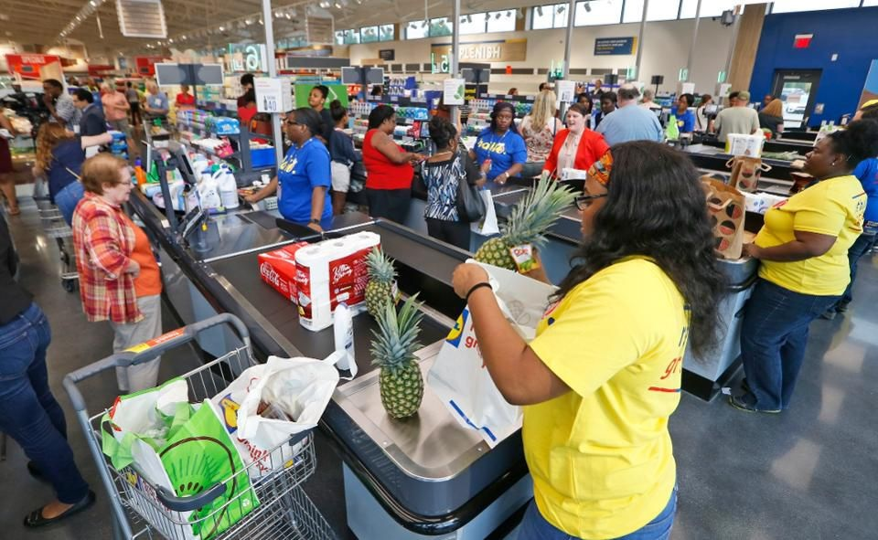
Assessing the worth of a Marketing Campaign
Retailers adopt multiple ways as part of promotional campaigns to entice customers to buy more and as a result boost sales.
Marketing Strategies:
Coupon discounts
Loyalty discounts
ATL & BTL Advertising
How should a retail firm determine whether their strategies are effective?

Slide 4
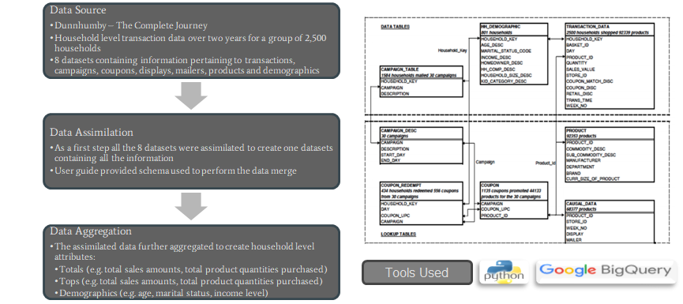
Data Sourcing, Assimilation & Aggregation

Slide 5
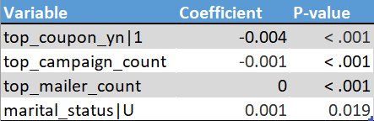
Gauging Responsiveness through Regression
Linear regression : Descriptive
Three models were fitted:
All customers included:
Do marketing campaigns affect customer purchases?
Model 1: total_cust_sales_bcox ~ top_coupon_yn + top_coupon_count + top_mailer_count + top_campaign_count + marital_status + income

Slide 6
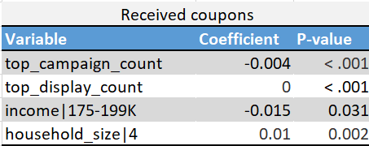
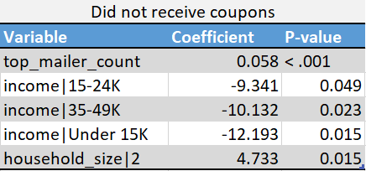
Gauging Responsiveness through Regression
2. Customers targeted/not targeted by a marketing campaign
Factors influencing customers purchases in these two segments
Similarities and differences in customers purchasing behavior
Model 2: total_cust_sales_bcox ~ top_campaign_count + top_display_count + income + household_size
Model 3: total_cust_sales_bcox ~ top_mailer_count + income + household size

Slide 7
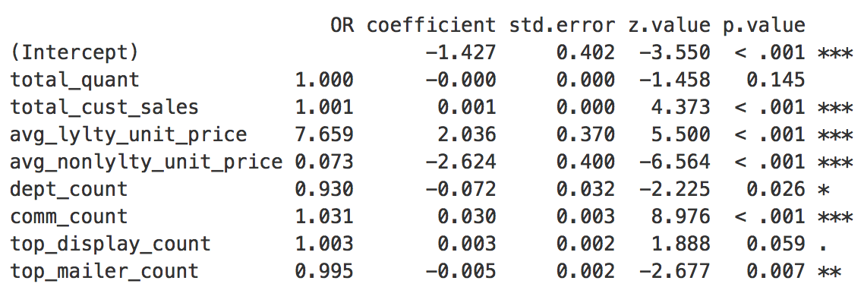
Predicting effects on discount availed
Logistic Regression:
To understand the effects of different variables on discount availed by a customer
Odds Ratio for display_count is slightly larger than mailer_count
Odds Ratio for loyalty program customers is quite high

Slide 8
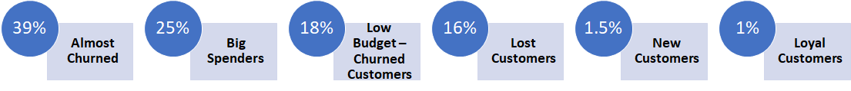
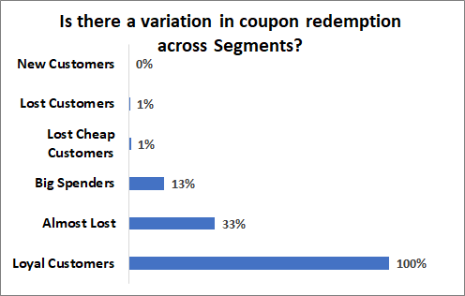
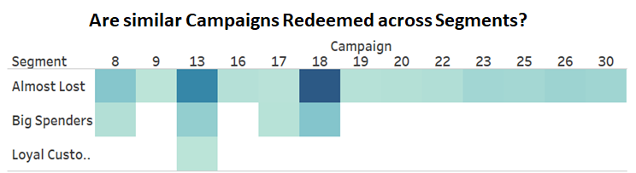
Segmenting Households through RFM Scoring
-Big Spenders account for 25% of the segment and need to be targeted with expensive marketing strategies
-Almost Churned customers need to be targeted with aggressive price incentives, to prevent churn
-33% of the Almost Lost customers have responded to coupons - implies that the coupons may have not done a great job in preventing churn

Slide 9

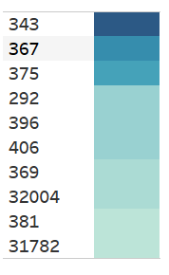
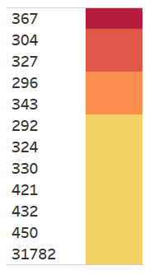
Shopping Behavior Across Segments
Are different segments shopping across similar stores?
BIG SPENDERS
ALMOST CHURNED
STORE ID
STORE ID
-As compared to Big Spenders store 343 features in the top of the most shopped store amongst Almost Churned Customers
-Store 367 seems to be a popular one across the customers

Slide 10
Judging the financial worth of a marketing campaign - ROI
Determining ROI requires an estimation of both the input costs in the marketing campaigns and the associated profits from the purchases correlated to the campaigns. Such calculations necessitate certain assumptions on the margins
Costs:
Coupon Discounts
Mailer Ads (Assume a $50 CPM - cost per thousand readers)
Display Ads (Assume ~ $12 per banner; consider commonly used vinyl banners)
Returns:
Consider net margin of 10% on consumer goods (Business Insider)
Screen out product transactions linked to promotional campaigns
Estimated ROI at ~ 2.20% -> Is it worthwhile? 60 bps above US GDP growth rate!

